Slide 1
Bike-Share Navigate Speedy Success
How Casual rider differ from annual member ?

Slide 2
Objective
Our team wants to understand how casual riders and annual members use Cyclistic bikes differently.
From these insights, our team will design a new marketing strategy to convert casual riders into annual members.

Slide 3
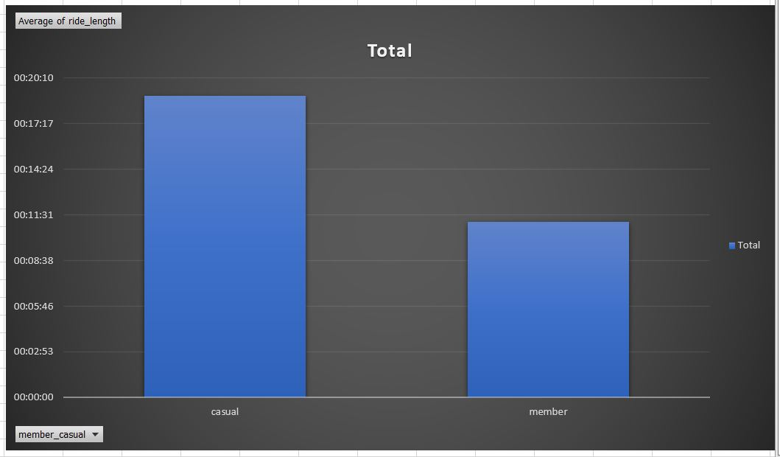
Average of ride_length :
From the bar graph it is clearly shown that casual ride used to have a greater avg ride_length than the annual member.
It can be infer that member used it for their small day to day rides.
While casual riders might used it as for a specific purposes.

Slide 4
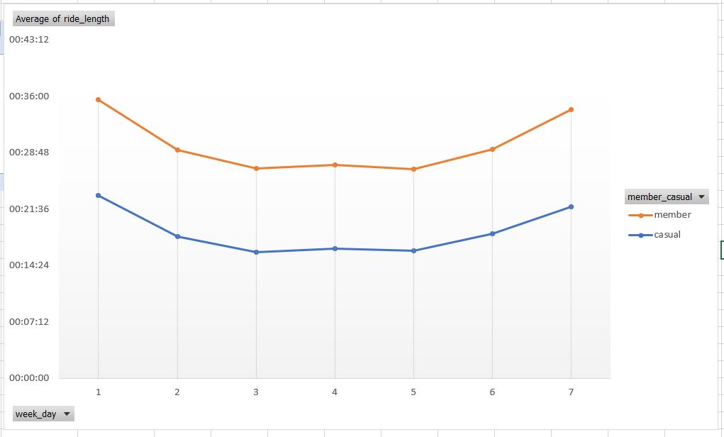
Weekday avg ride length
We observe a similar avg_ride length pattern for both casual and member along the different weekdays , casual rider being have the larger avg_ride_length in each day.
From this we can infer that our target audience used the Bike share more during weekends than the weekdays.

Slide 5
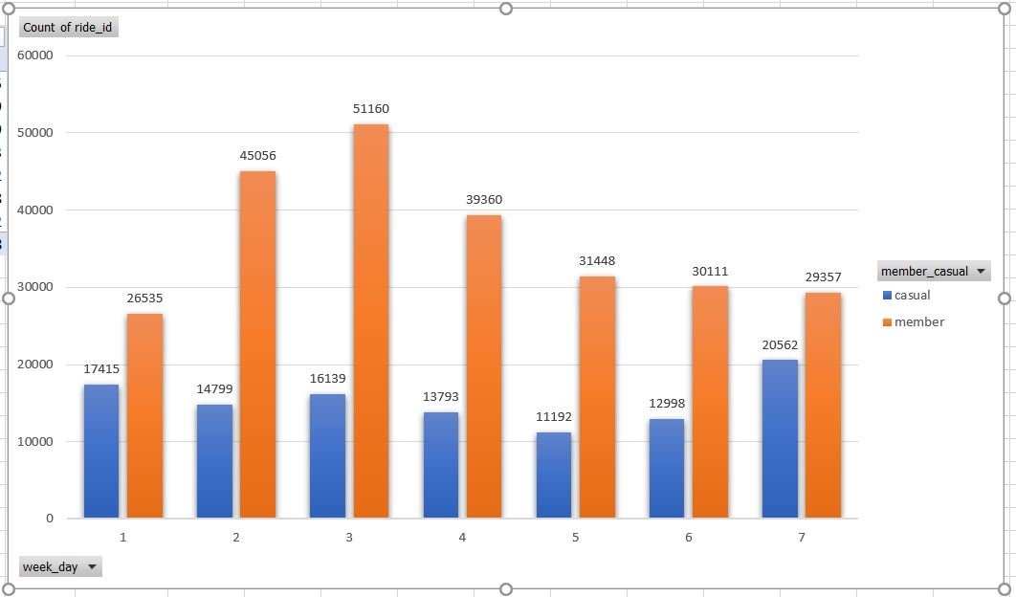
Count of number of ride by Weekday
The number of rides taken by the member in the weekdays generally larger than twice of casual days.
We also observe a significant number of rides being taken by the members in weekends than the casual riders.

Slide 6
Recommendation:
Number of rides taken by the member are significantly larger than the casual riders . So, we need to focus on converting the casual to annual member in our advertise campaign.
We also need to focus on increasing the average ride time of member by giving some attractive offers.
We should launch some attractive offers for both casual and member on weekdays to increase the number of riders in the weekdays.

